Slide 1


Izet Dautovic
02/17/2022

Slide 2

Outline
Executive Summary
Introduction
Methodology
Results
Conclusion
Appendix

Slide 3
Executive Summary
Summary of methodologies
Data Collection through API
Data Collection with Web Scraping
Data Wrangling
Exploratory Data Analysis with SQL
Exploratory Data Analysis with Data Visualization
Interactive Visual Analytics with Folium
Machine Learning Prediction
Summary of all results
Exploratory Data Analysis result
Interactive analytics in screenshots
Predictive Analytics result

Slide 4
Introduction
Project background and context
Space X advertises Falcon 9 rocket launches on its website with a cost of 62 million dollars; other providers cost upward of 165 million dollars each, much of the savings is because Space X can reuse the first stage. Therefore, if we can determine if the first stage will land, we can determine the cost of a launch. This information can be used if an alternate company wants to bid against space X for a rocket launch.
What is the problem, what we trying to find out?
What factors determine if the rocket will land successfully?
The interaction amongst various features that determine the success rate of a successful landing.
What operating conditions needs to be in place to ensure a successful landing program.

Slide 5

Section 1

Slide 6
Methodology
Executive Summary
Data collection methodology:
Data collected utilizing SpaceX API and web scraping from Wikipedia.
Perform data wrangling
One-hot encoding applied to categorical features and dropping irrelevant columns
Perform exploratory data analysis (EDA) using visualization and SQL
Utilizing Scatter and Bar Charts to show relationships and patterns between variables.
Perform interactive visual analytics using Folium and Plotly Dash
Perform predictive analysis using classification models

Slide 7
Data Collection
For our project, we utilize two data set;
SpaceX REST API
Wikipedia table by web scraping method to extract data from the web.
Process used to obtain data set as follow:
SpaceX API
Web Scraping
Request data from SpaceX API
Request and get HTML response from Wikipedia
Receive data from SpaceX via .JSON format
Extract data using beautiful soup
Normalize data to CSV flat file
Normalize data to CSV flat file

Slide 8
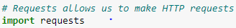
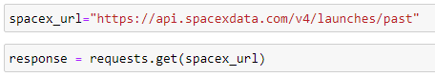
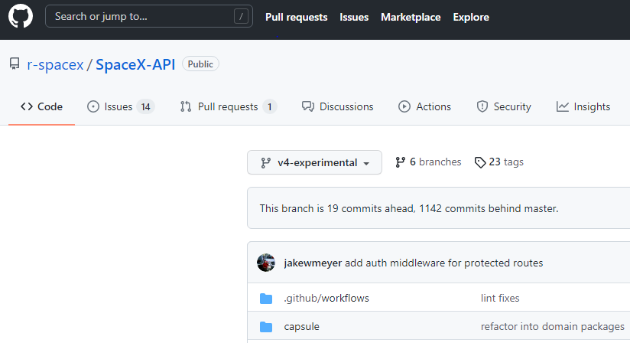
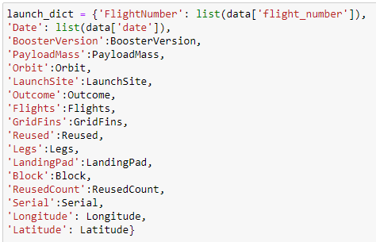
Data Collection – SpaceX API
We used the GET request to the SpaceX API to collect data, clean the requested data and did some basic data wrangling and formatting.
Load request library and request rocket data from SpaceX API
SpaceX API
2. Converting response to a JSON format
3. Apply predefined helper functions to clean data
def getBoosterVersion(data) | def getLaunchSite(data) | def getPayloadData(data) | def getCoreData(data):
4. Assign list to dictionary and create new data frame
GitHub URL
Gists URL
5. Filter, replace missing data and export final .CSV flat file

Slide 9

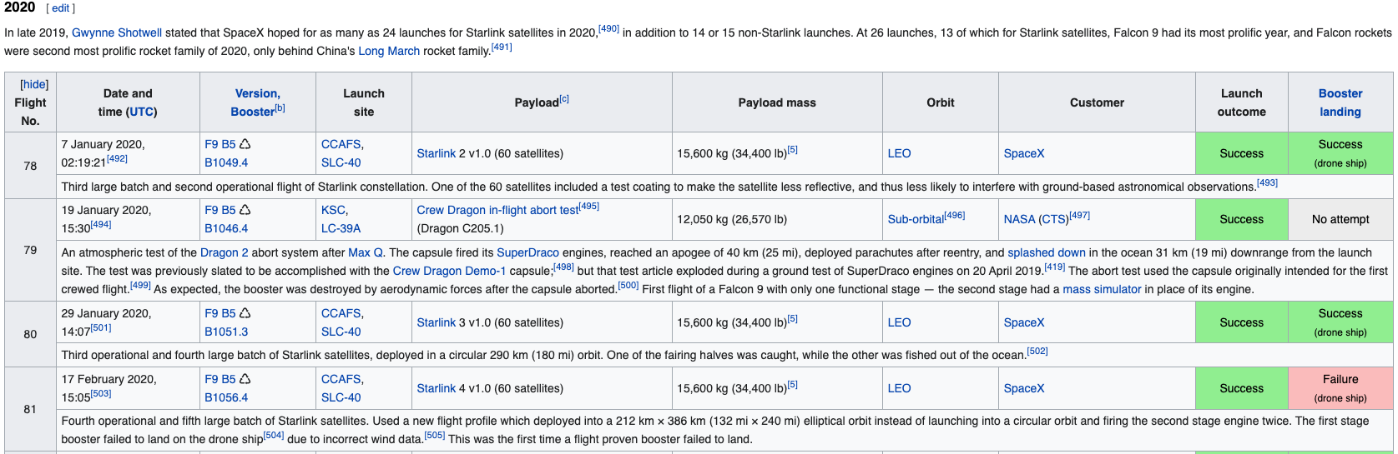
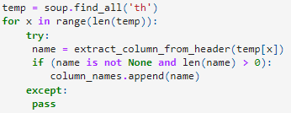
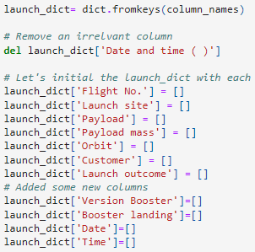
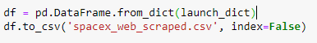
Data Collection - Scraping
We applied web scraping technique to webscrap Falcon 9 launch records from Wikipedia and pursed with BeautifulSoup into the table and then converted to a pandas dataframe.
Request the HTML page from the URL and get a response object
static_url = "https://en.wikipedia.org/w/index.php?title=List_of_Falcon_9_and_Falcon_Heavy_launches&oldid=1027686922"
2. Create BeautifulSoup Object and find table
3. Getting Columns Names and creation of dictionary
4. Append Data to keys and convert to dataframe
GitHub URL Gists URL
5. Extract data from datafram to .CSV flat file

Slide 10
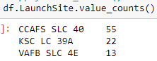
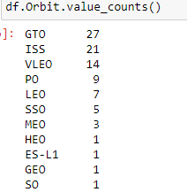
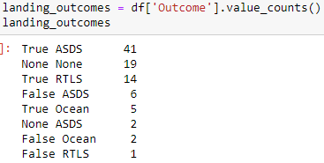
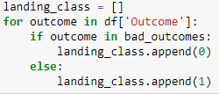
Data Wrangling
EDA: Load Data, identify data type and if any data missing
We perform Exploratory Data Analysis (EDA) to find some patterns in the data and determine what would be the label for training supervised models.
In the data set, there are several different cases where the booster did not land successfully. Sometimes a landing was attempted but failed due to an accident; for example: Outcomes:
True Ocean = successfully landed to a specific region of the ocean
False Ocean = unsuccessfully landed to a specific region of the ocean
True RTLS = successfully landed to a ground pad
False RTLS = unsuccessfully landed to a ground pad
True ASDS = successfully landed on a drone ship
False ASDS = unsuccessfully landed on a drone ship
In this lab we will convert outcomes into Training Labels as:
1 = successfully landed 0 = unsuccessful landing
2. Calculate the number of launches at each site
3. Calculate the number of occurrence of each orbit
4. Create a landing outcome label from outcome column
5. Calculate success rate and export dataframe to .CSV
GitHub URL
Gists URL

Slide 11
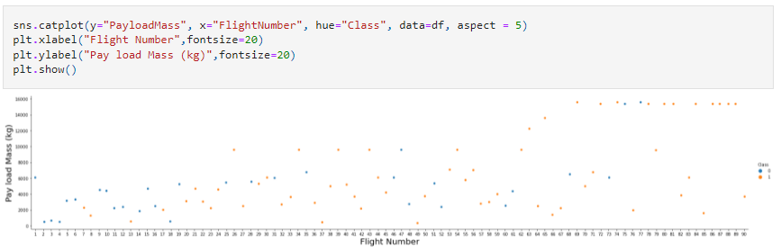
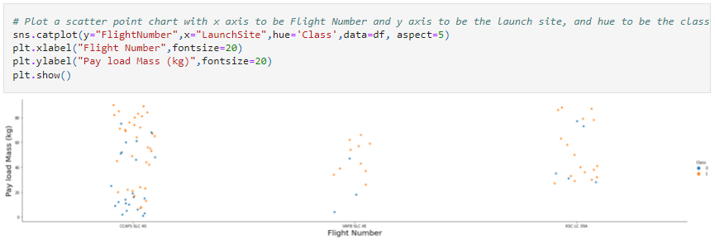
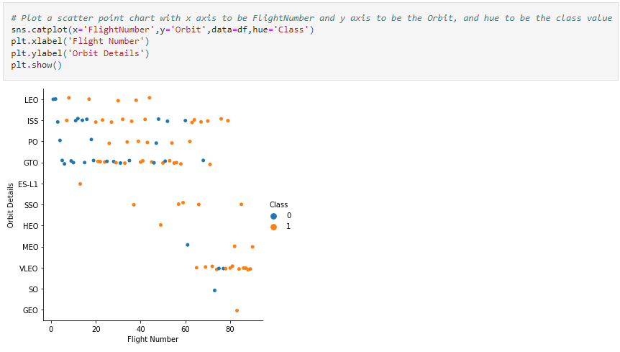
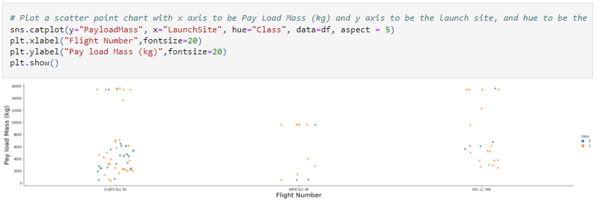
EDA with Data Visualization - Scatter Chart
We explored the data by visualizing the relationship between:
Flight Number vs. Launch Site
Payload vs. Launch Site
Flight Number vs. Orbit Type
Payload vs. Orbit Type
A scatter plot shows how much one variable is affected by another. The relationship between two variables is called a correlation. This type of chart is generally composed of large data set.
GitHub URL
Gists URL

Slide 12
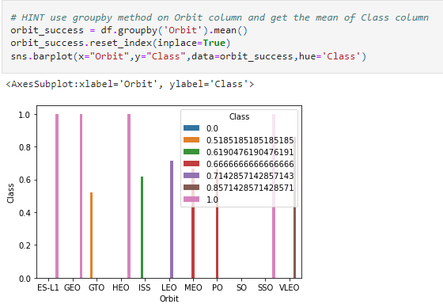
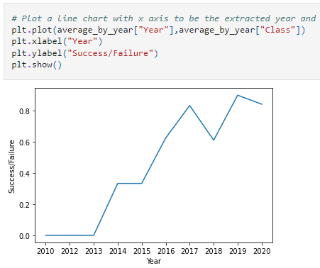
EDA with Data Visualization - Bar & Line Chart
We explored the data by visualizing the relationship between:
Orbit Type vs. Success Rate
We used a bar chart which makes it easy to compare datasets between multiple groups at a glance. One axis represents a category and the other axis represents a discrete value. The purpose of this chart is to indicate the relationship between the two axes.
Year vs Success Rate
For this analysis we use a line chart which shows data variables and trends very clearly and helps predict the results of data that has not yet been recorded.
GitHub URL
Gists URL

Slide 13
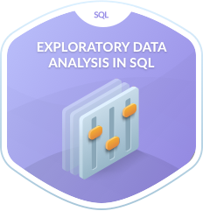
EDA with SQL
First, we created table within Db2 database and then we loaded the SpaceX dataset.
Second, we applied EDA with SQL to get insight from the data. We completed following queries:
Displaying the names of the unique launch sites in the space mission
Displaying 5 records where launch sites begin with the string 'KSC'
Displaying the total payload mass carried by boosters launched by NASA (CRS)
Displaying average payload mass carried by booster version F9 v1.1
Listing the date when the first successful landing outcome in drone ship was achieved
Listing the names of the boosters which have success in ground pad and have payload mass greater than 4000 but less than 6000
Listing the total number of successful and failure mission outcomes
Listing the names of the booster_versions which have carried the maximum payload mass. Use a subquery
List the records which will display the month names, successful landing_outcomes in ground pad ,booster versions, launch_site for the months in year 2017
Rank the count of successful landing_outcomes between the date 2010-06-04 and 2017-03-20 in descending order.
GitHub URL
Gits URL

Slide 14
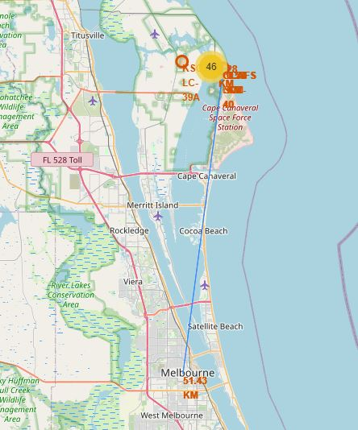
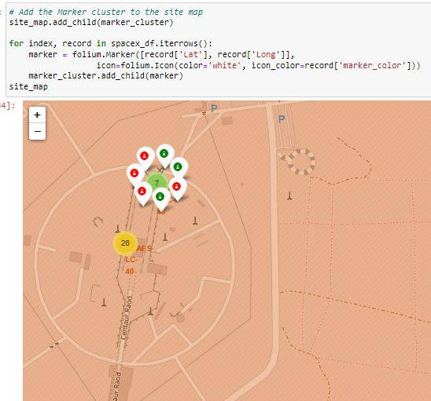
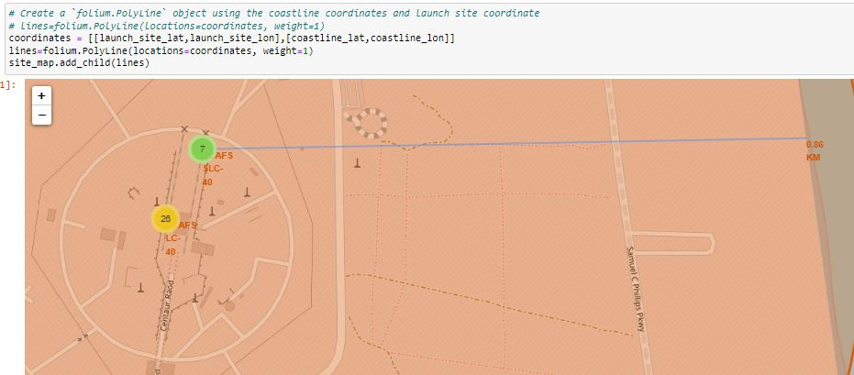
Build an Interactive Map with Folium
We took the Latitude and Longitude coordinates at each launch site and added a Circle Marker around each launch site with a label of the name of the launch site.
We created and added following object to a folium map:
Markers that show all launch sites on a map
Success/failed launches markers for each site as (1,0) or Green and Red markers utilizing MarkerCluster()
Lines that show the distances between a launch site
By adding these objects we were able identify following geographical patterns about launch sites:
Are launch sites in close proximity to railways? Yes
Are launch sites in close proximity to highways? Yes
Are launch sites in close proximity to coastline? Yes
Do launch sites keep certain distance away from cities? Yes
GitHub URL
Gits URL

Slide 15
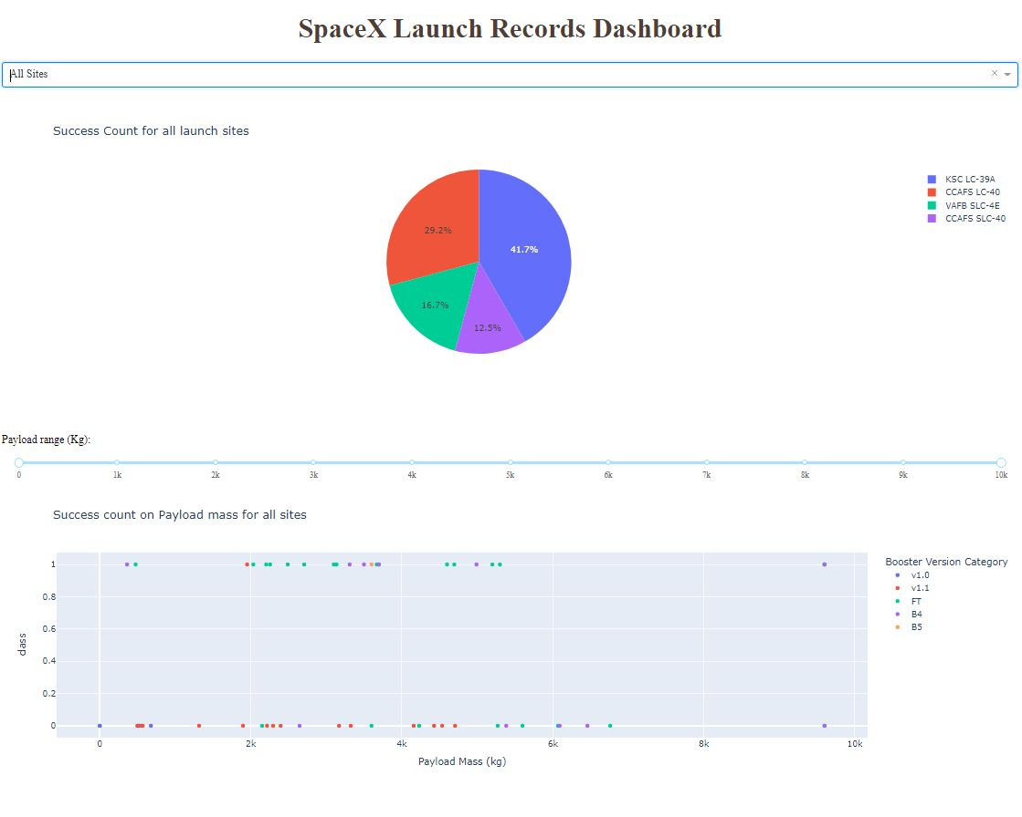
Build a Dashboard with Plotly Dash
We built an interactive dashboard with Plotly dash
Pie charts showing the total launches by a certain sites
Scatter graph showing the relationship with Outcome and Payload Mass (Kg) for the different booster version.
Code Only: GitHub URL Gists URL

Slide 16
Predictive Analysis (Classification)
Building Model
Load dataset into NumPy and Pandas
Standardize and transform Data
Split data into training and test data sets
Check how many test samples we have
Set regression object, then create GridSearchCV object
Fit datasets into the GridSearchCV objects and train our dataset.
Evaluating Model
Check accuracy for each model
Plot Confusion Matrix
Improve Model
Algorithm Tuning
Finding the best performing model The best accuracy score wins the best performing model
Build
Results
Evaluate
Improve
GitHub URL
Gists URL

Slide 17
Results
Exploratory data analysis results
Interactive analytics demo in screenshots
Predictive analysis results

Slide 18

Section 2

Slide 19
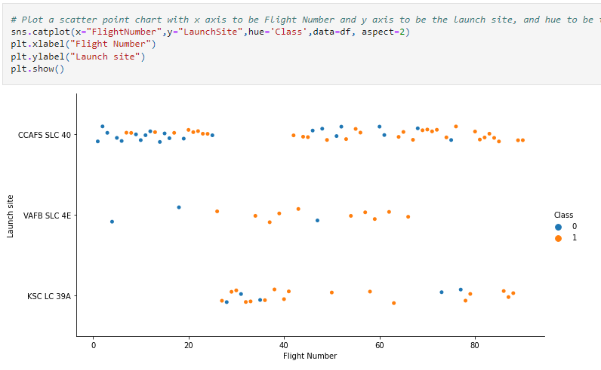
Flight Number vs. Launch Site
This figure shows that the success rate increased as the number of flights increased for each site. Also, there seem to be increase in success rate after 20th flight.
Legend: Class 0 (blue) = unsuccessful launch Class 1 (orange) = successful launch.

Slide 20
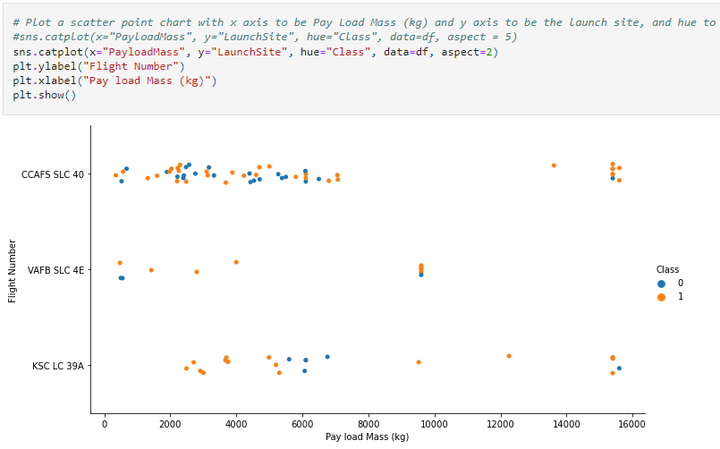
Payload vs. Launch Site
We can see that for the VAFB-SLC launchsite there are no rockets launched for heavy payload mass >10,000 (kg). Also we can see there is no significant or clear pattern between Launch Site and Payload Mass for a successful launch.
Legend: Class 0 (blue) = unsuccessful launch Class 1 (orange) = successful launch.

Slide 21
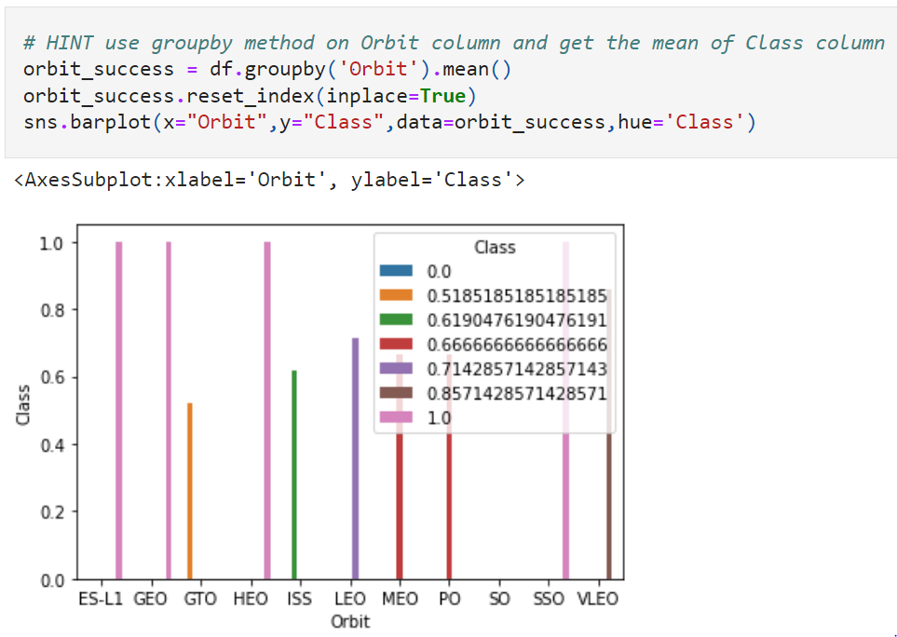
Success Rate vs. Orbit Type
Highest Success Rate
Orbit types SSO, HEO, GEO, and ES-L1 have the highest success rates (100%).
Lowest Success Rate
Orbit types GTO, ISS, MEO (<70%).

Slide 22
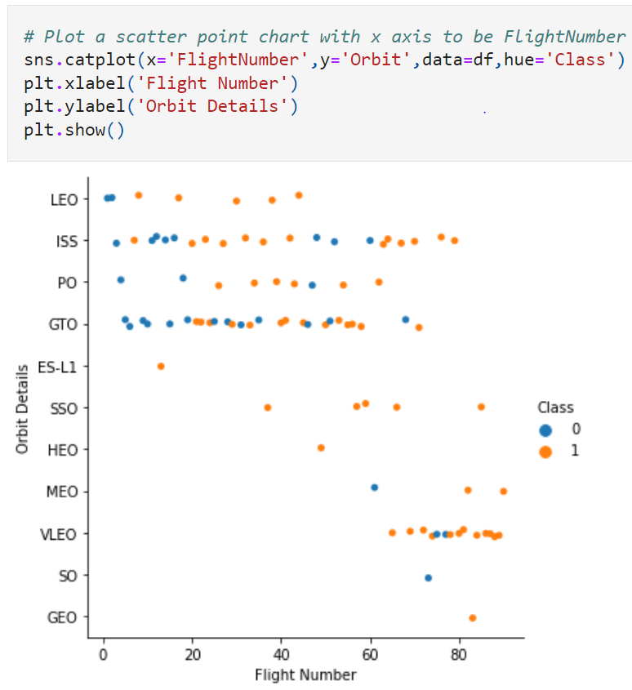
Flight Number vs. Orbit Type
It appears SpaceX started with LEO orbit with moderate success rate.
SSO orbit seems to be successful, although number of light seems to be low.
GTO and ISS orbit, there seems to be no relationship between flight numbers and success rate.
VLEO has a high success rate, is used the most in recent launches.
Legend: Class 0 (blue) = unsuccessful launch Class 1 (orange) = successful launch.

Slide 23
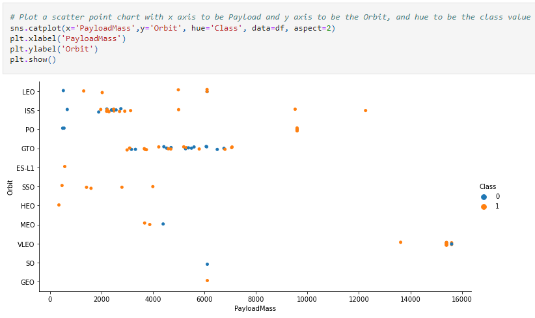
Payload vs. Orbit Type
LEO orbit has moderate success rate for payload less than 6K kg
SSO orbit seems to be successful for lower payload, we can observe that no payload is sent greater than 5K kg.
GTO and ISS orbit, there seems to be no relationship between flight numbers and success rate.
VLEO has a high success rate, is used the most in recent launches.
Legend: Class 0 (blue) = unsuccessful launch Class 1 (orange) = successful launch.

Slide 24
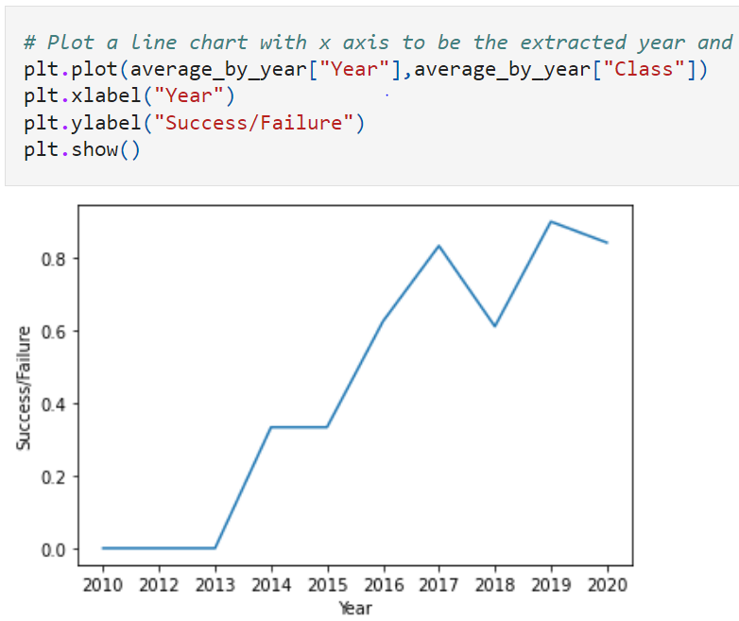
Launch Success Yearly Trend
We can observe that success rate since 2013 kept increasing till 2020, this is good new for future flights.

Slide 25
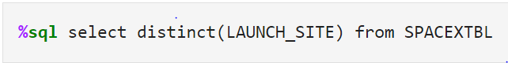
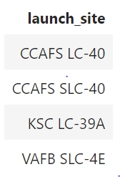
All Launch Site Names
To identify unique launch site, we use sql DISTINCT clause in the query.

Slide 26
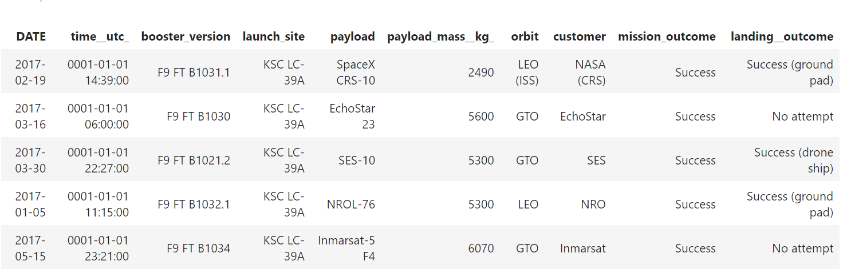
Launch Site Names Begin with 'KSC'
To find records where launch sites’ names start with `KSC` we use LIKE operator and percent sign (%) after keyword, for example; “like ‘KSC%’” This will give us all records where “launch site” starts with “KSC”
To limit number of records in the query we use “LIMIT” operator, for example “limit 5”

Slide 27
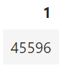
Total Payload Mass
To calculate total payload carried by boosters from NASA we use SUM() function.
We have to include WHERE clause, this will calculate total payload only from NASA
Payload

Slide 28
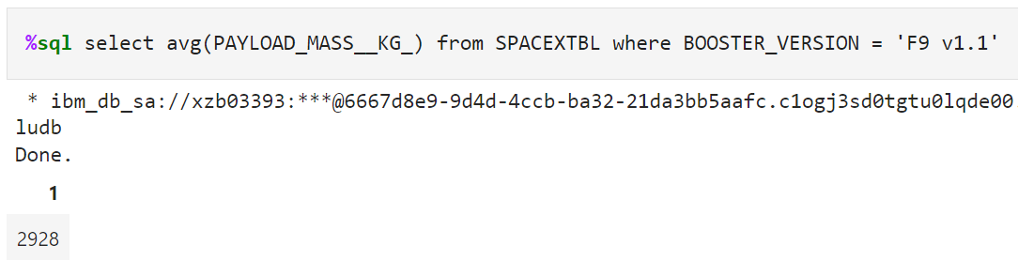
Average Payload Mass by F9 v1.1
To calculate average payload mass carried by booster version F9 v1.1 we use AVG() function and WHERE clause to identify Booster version.
Payload

Slide 29
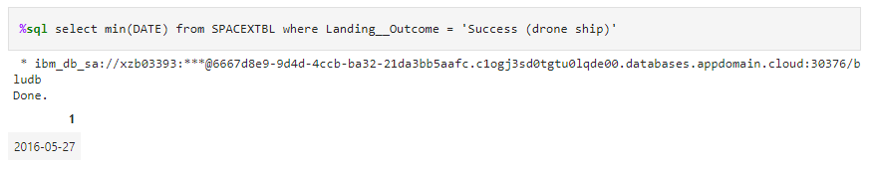
First Successful landing outcome in drone ship
To find first successful landing outcome on drone ship we use MIN() function to find the earliest date in the column DATE and used WHERE clause to find landing outcome is “Drone Ship”
Min Date

Slide 30
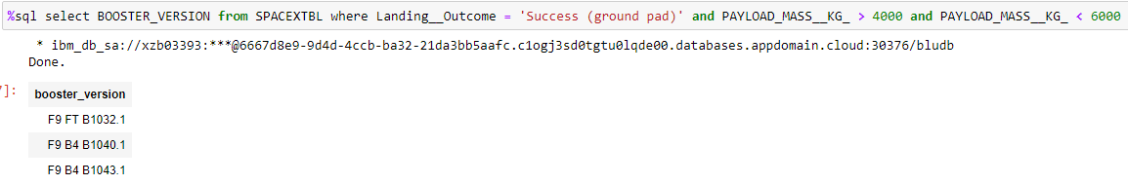
Successful Ground Pad with Payload between 4000 and 6000
To find the list of the names of boosters which have successfully landed on ground pad and had payload mass greater than 4000 but less than 6000 we use WHERE clause to find lading outcome is success for Ground Pad and we use AND and greater than “>” and Less Than (<) operator to identify payload mass.

Slide 31
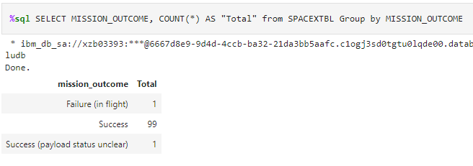
Total Number of Successful and Failure Mission Outcomes
To calculate the total number of successful and failure mission outcomes we use COUNT() function and we GROUP BY clause to group by mission outcome status.

Slide 32
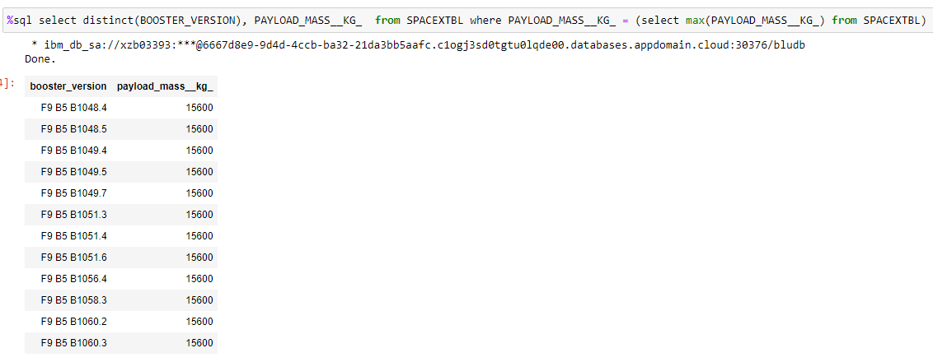
Boosters Carried Maximum Payload
To find Max Payload, we use a subquery, first, find the maximum value of the payload by using MAX() function, and second, filter the dataset to perform a search if PAYLOAD_MASS__KG_ is the maximum value of the payload. According to the result, version F9 B5 B10xx.x boosters could carried the maximum payload.

Slide 33
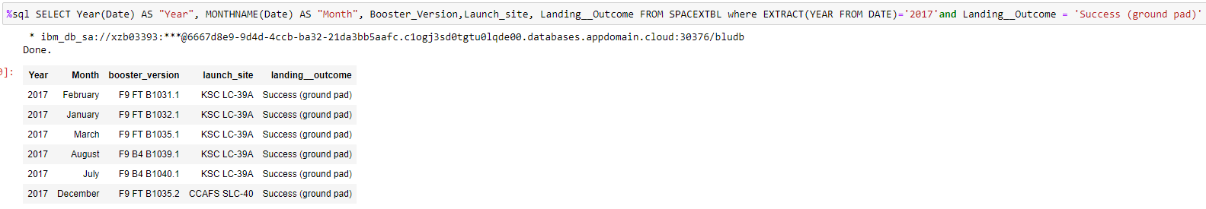
2017 Launch Records
To find list of successful landing_outcomes in ground pad ,booster versions, launch_site for the year 2017, we need to use EXTRACT clause to convert date to Year and filter landing outcome for successful landing for ground pad. Also we converted date to month as name.

Slide 34
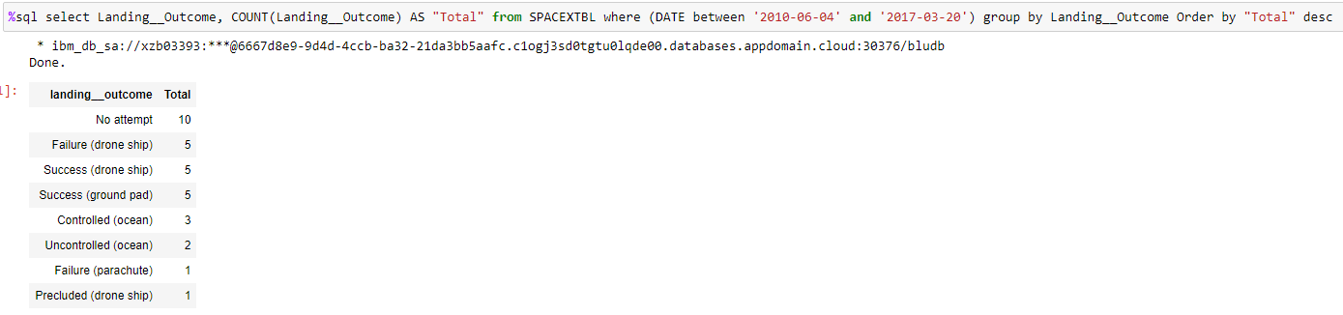
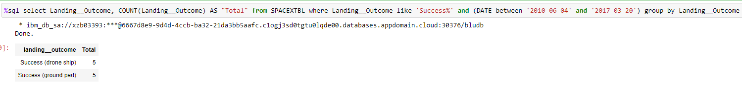
Rank Landing Outcomes Between 2010-06-04 and 2017-03-20
To find total rank for landing outcome we use WHERE clause, filter the dataset to perform a search if the date is between 2010-06-04 and 2017-03-20. Then we Using the ORDER BY clause to sort the records by total number of landing, and using DESC keyword to sort the records in descending order.
To find rank and count of successful landing_outcomes between the date 2010-06-04 and 2017-03-20 in descending order we use the same query but this time we added additional WHERE clause for Success.

Slide 35

Section 3

Slide 36
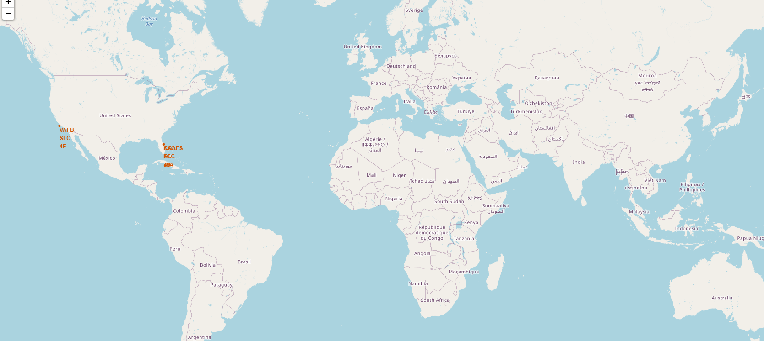
All Launch Site - Global Map
SpaceX has two launch site, both site are in United States, one east cost, Florida and other is west cost, California

Slide 37
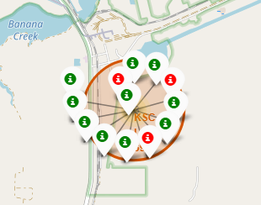
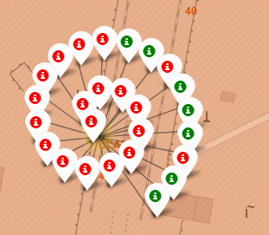
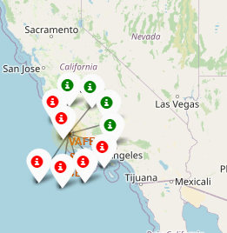
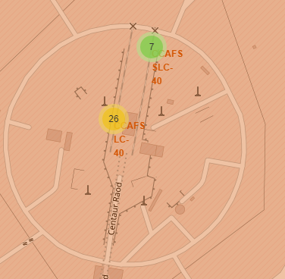
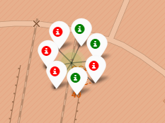
Markers showing launch site with color labels
Florida
California

Slide 38
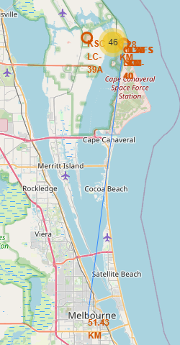
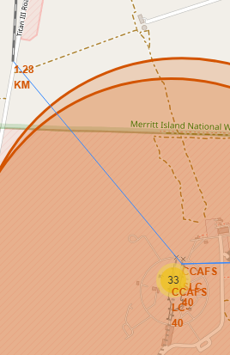
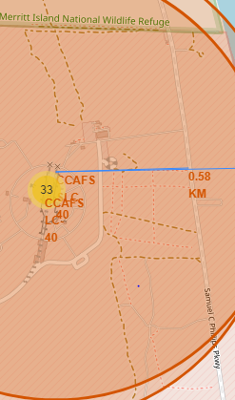

Distance from Launch Site to Landmarks
Closest City
Closest Railway
Closest Highway
Closest Coast

Slide 39

Section 4

Slide 40
SpaceX Launch Records Dashboard
SpaceX Launch Dashboard contains following key elements.
Dropdown with all launch sites
Success Rate Pie Chart
Payload Range Selector
Count of successful payload for all sites

Slide 41

Launch Sites
Success rate by all sites
Top, the most successful launch site is KSC LC-39A
Second,successful launch site is CCAFS LC-40
Least successful launch site is CCAFS SLC-40

Slide 42

Highest Launch Success Ratio
Based on data, highest launch success Ratio is by KSC LC-39A
~77% success rate

Slide 43

Payload vs Launch Outcome <=10K
Based on data representing payload vs outcome launch, we can see distinct difference in success rate between heavy and light payload. For example:
0 - 2K 38% success rate, not significant success rate but on right track
2K - 4K 60% success rate, the best success rate
4K-6K 38% success rate, not significant success rate but on right track
6K-8K 0% success rate, although there is few data points, this can be considered as insufficient
8K-10K 50% success rate, not enough data, it can be considered outliers
It appear that best success rate for the boost version is FT version.

Slide 44
SpaceX Dashboard Workbook
Dashboard (Code Only)
https://gist.github.com/idautovic/0bc8afcbd9823e58c591f7897d4c1a07

Slide 45

Section 5

Slide 46

Classification Accuracy
The decision tree classifier is the model with the highest classification accuracy

Slide 47

Confusion Matrix
The confusion matrix is the same for all models because all models performed the same for the test set.
Examining the confusion matrix, we see that logistic regression can distinguish between the different classes. We see that the major problem is false positives.

Slide 48
Conclusions
Based on SpaceX data analysis we can conclude that.
Success rate is correlated to the number of flights and time. As the number of flights increased, the success rate increased. This indicates that is constant improvement and eventually spacex will get to six sigma quality and ~99.99% success rate.
Orbital types = SSO, HEO, GEO, ES-L1 = highest success rate (100%).
KSLC-39A site has highest number of successful launch.
Payload between 2K-6K under “FK” Booster performed the best.
Tested model, all models have the same accuracy (83.33%).
The launch site is close to railways, highways, and coastline, but far from cities.
The Decision tree classifier is the best machine learning algorithm for analysis.

Slide 49
Data Sources
Data Collection API
spacex_url="https://api.spacexdata.com/v4/launches/past"
Web scraping
static_url = "https://en.wikipedia.org/w/index.php?title=List_of_Falcon_9_and_Falcon_Heavy_launches&oldid=1027686922"
EDA Data Wrangling
df=pd.read_csv("https://cf-courses-data.s3.us.cloud-object-storage.appdomain.cloud/IBM-DS0321EN-SkillsNetwork/datasets/dataset_part_1.csv")
EDA with Data Visualization
df=pd.read_csv("https://cf-courses-data.s3.us.cloud-object-storage.appdomain.cloud/IBM-DS0321EN-SkillsNetwork/datasets/dataset_part_2.csv")
EDA with SQL
https://cf-courses-data.s3.us.cloud-object-storage.appdomain.cloud/IBM-DS0321EN-SkillsNetwork/labs/module_2/data/Spacex.csv?utm_medium=Exinfluencer&utm_source=Exinfluencer&utm_content=000026UJ&utm_term=10006555&utm_id=NA-SkillsNetwork-Channel-SkillsNetworkCoursesIBMDS0321ENSkillsNetwork26802033-2021-01-01
Machine Learning
data = pd.read_csv("https://cf-courses-data.s3.us.cloud-object-storage.appdomain.cloud/IBM-DS0321EN-SkillsNetwork/datasets/dataset_part_2.csv")
Launch Sites Locations Analysis with Folium
wget.download('https://cf-courses-data.s3.us.cloud-object-storage.appdomain.cloud/IBM-DS0321EN-SkillsNetwork/datasets/spacex_launch_geo.csv')
Launch Site Dashboard
wget "https://cf-courses-data.s3.us.cloud-object-storage.appdomain.cloud/IBM-DS0321EN-SkillsNetwork/datasets/spacex_launch_dash.csv"
wget "https://cf-courses-data.s3.us.cloud-object-storage.appdomain.cloud/IBM-DS0321EN-SkillsNetwork/labs/module_3/spacex_dash_app.py"

Slide 50
Workbooks
Data Collection API
https://gist.github.com/idautovic/f5beef6ebdb4af3d9280aa4902f556bf
Data Collection Web Scraping https://gist.github.com/idautovic/6b7696d97396f03b8c51d686bafe6028
EDA Data Wrangling https://gist.github.com/idautovic/49cacfc34619f8ae35b54e9dda1cbee6
EDA with Data Visualization
https://gist.github.com/idautovic/285838d3366a8844621e5237ec2b2243
EDA with SQL
https://gist.github.com/idautovic/40a8f1cbc7e2a2c5af1a31efba734036
Machine Learning https://gist.github.com/idautovic/2202a4c30dcb3863f71eaaf14160a434
SpaceX Dashboard (Code Only)
https://gist.github.com/idautovic/0bc8afcbd9823e58c591f7897d4c1a07

Slide 51

Appendix

Slide 52


